Slide 1

WELCOME TO
MONEY BASICS
Facilitated by:
[Facilitator 1 name]
[Facilitator 2 name]

Slide 2
Introduction
Workshop 1
PG. 9 IN STUDENT GUIDE

Slide 3

Welcome
Congratulations on making the decision to take positive steps toward greater financial security!
Money Basics is a financial empowerment course designed specifically for individuals with lived experience of mental health and/or addiction challenges.
By building upon your existing knowledge, strengths, and experiences, this course will enable you to build financial resilience, reduce financial stress, and feel empowered to budget, save, and spend money in ways that work for you.

Slide 4
Facilitator Introductions

Slide 5

Introductions
Please tell us:
Your preferred name
How you would like to be referred to
Where you are from
Why you are interested in attending these workshops

Slide 6

Zoom Etiquette
Mute your microphone when not speaking
Stay on video as much as you can
Use the chat at any time to make comments and ask questions
Use the “raise hand” function
Headphones recommended

Slide 7

Ground Rules:
Listen: Listen carefully to other speakers and to your own reactions.
Respect: Accept the validity of another point of view, even if you disagree.
Suspend judgment: Approach other people’s opinions with an open mind.
Speak up: Share your views fully and honestly with everyone
Above all, we want you to:
Feel comfortable sharing your thoughts and experiences;
Ask questions at any time;
Be kind to yourself and others.

Slide 8

Course Goals:
New knowledge & skills: Participants will leave the course with increased knowledge and improved skills relating to money and finances.
Confidence: Participants will have greater confidence handling their finances.
Financial goals & a plan to achieve them: Participants will have healthy financial goals and habits and will be able to question and reflect on their current financial situation so they can strategize ways to improve it.
Reduced financial stress: Participants’ feelings of shame or hopelessness around money and financial situations are reduced as they learn new information and skills in a safe environment.

Slide 9

Expectations for Participants:
Please turn off or silence your cell phones
Please be on time for the class and return from breaks and on time
If you are going to be late or are unable to attend, please notify the facilitator(s) via phone or email as soon as possible.
Participation in group discussion is an important part of the learning process.
Please respect others at all times and during all interactions.

Slide 10
Community Agreements

Slide 11

Today’s Agenda:
Go over the course goals, rules, and schedule; create a community agreement.
Recognize pervasive thoughts, beliefs, and emotions we have about money.
Think about the relationship between our mental health and/or challenges and our financial challenges.
Identify ways to reduce financial stress and practice self-care.
Learn about poverty, economic inequality, and economic insecurity in the United States and how these issues are intersectional.
Learn about and discuss privilege, social justice, equity, and financial resilience.
Identify our own individual course goals.

Slide 12
Course Overview
Workshop 1 - Introduction to Money Basics
Welcome & introductions
Ground rules, course goals
Thoughts & beliefs about money
Mental health/addiction and money issues
Mindfulness tips to reduce financial stress
Poverty, intersectionality, privilege & social justice
Economic resilience
Individual course goals
Money saving ideas
Workshop 2 – Financial Goals, Person Directed Plan
Class updates and sharing
Person-directed planning
Life now; what works and what doesn’t
Strengths, gifts, capacities
Financial dream, life one year from now
Action Plan
Workshop 3 – Creating a Budget, Resources to Save Money
Class updates and sharing
Fixed, variable, non-monthly, and unexpected expenses
Income and expenses; needs vs wants
Budgeting worksheet(s)
National and local resources for saving money
Workshop 4 – Banking Basics & Checking Accounts
Class updates and sharing
Banking terms
Different types of financial institutions
Common fees and how to avoid them
What to do if you have poor banking history
Checking accounts; how to read and write a check
How to balance your checkbook
Workshop 5 – Debit Cards, ATMs, Online Banking & Money Safety
Class updates and sharing
Debit card basics
ATM basics, ATM safety
Online banking, mobile banking, automatic bill paying
Direct deposit; Debit system through Social Security
Money safety; tips and resources to avoid identity theft
Workshop 6 – Credit & Loans
Class updates and sharing
How credit works, credit facts and terms; pros and cons of credit
Healthy credit habits; how to rebuild credit
Steps to paying down credit cards
Reasons for taking out a loan; pros and cons of loans
Understanding loan contracts and interest rates
Predatory lending: warning signs and resources

Slide 13
Course Overview
Workshop 7 – Debt & Tools to Get Out of it
Class updates and sharing
Thoughts on debt
Figuring out how much you owe, debt-to-income ratio
Organizing payment methods
Other options for paying off debt
Pros and cons of bankruptcy
Person-directed plan for getting out of debt
Workshop 8 – Mental Health, Relationships & Money; Financial Crisis Planning
Class updates and sharing
The relationship between mental health challenges, money, and poverty
The relationship between addiction and financial issues
Creating a Financial Crisis Plan
Relationship issues and money
Financial abuse: warning signs and resources
Workshop 9 – How to File Taxes & Resources for Doing So
Class updates and sharing
Why we file taxes; government revenue
Federal vs state taxes
Common forms and terms
How to file a federal income tax return
Resources for filing: IRS Free File, VITA, TCE
Claiming deductions and credits
Owing and paying taxes; payment plans
Tax extensions and back taxes
Workshop 10 – Savings Accounts & Saving Goals
Class updates and sharing
Different types of savings accounts; pros and cons
Asset building, Individual Development Accounts
Retirement plans
Savings goals: dreaming big with minimal resources
How to save money on a limited income
Savings goals; planning saving into your budget

Slide 14
Forms
Pre-Course Questionnaire
Demographics & Registration Form
Class Topics Questionnaire
The course is flexible and we will focus on the topic areas that are most important and useful for you.

Slide 15

Thoughts & Beliefs about Money
Part 1 (journal):
What thoughts, beliefs or emotions have you had about money?
What thoughts and beliefs have you heard from others or the media?
Part 2 (discussion):
Are these words positive, negative or neutral?
How would you like to feel about money?

Slide 16

Mental Health and/or Addiction & Money
Journal & Discuss:
In what ways have mental health issues affected your financial situation?
In what ways has your financial situation affected your mental health?

Slide 17

Mindfulness to Reduce Financial Stress
Tips for practicing mindfulness on a budget:
get enough sleep
go on a walk, exercise, do yoga or stretches
meditate, practice deep breathing
connect with friends and family
spend time outside
journal
practice gratitude, self-compassion, and forgiveness
Why do you think self-care is important?

Slide 18
Poverty in the United States
In 2019, an estimated 34 million Americans were living in poverty, made worse by the COVID-19 pandemic.
Many individuals and families remain in or are on the brink of poverty, facing food or housing insecurity, unemployment, low incomes, debt, and barriers to education and stability.
There are high levels of income and wealth inequality in the United States.
Classism:
Differential treatment based on social class or perceived social class, usually in a way to oppress working-class people and maintain the power of the wealthy class.
Poverty is intersectional. Poverty cannot be separated from the other structural inequalities that shape society.
Systemic racism, including a history of redlining and housing segregation, has led to a racial wealth gap.

Slide 19
Intersectionality & Privilege
Intersectionality: the many systems of oppression in our society (racism, sexism, classism, ableism, homophobia, transphobia, xenophobia) simultaneously overlap and interlock – they are intersectional.
“It’s basically a lens, a prism, for seeing the way in which various forms of inequality often operate together and exacerbate each other. We tend to talk about race inequality as separate from inequality based on gender, class, sexuality or immigrant status. What’s often missing is how some people are subject to all of these, and the experience is not just the sum of its parts.” – Kimberlé Crenshaw.
Privilege: the unearned advantages and power that an individual receives from belonging to a certain social identity group.
White privilege refers to the unearned power and opportunities that White people experience simply because of their skin color.

Slide 20
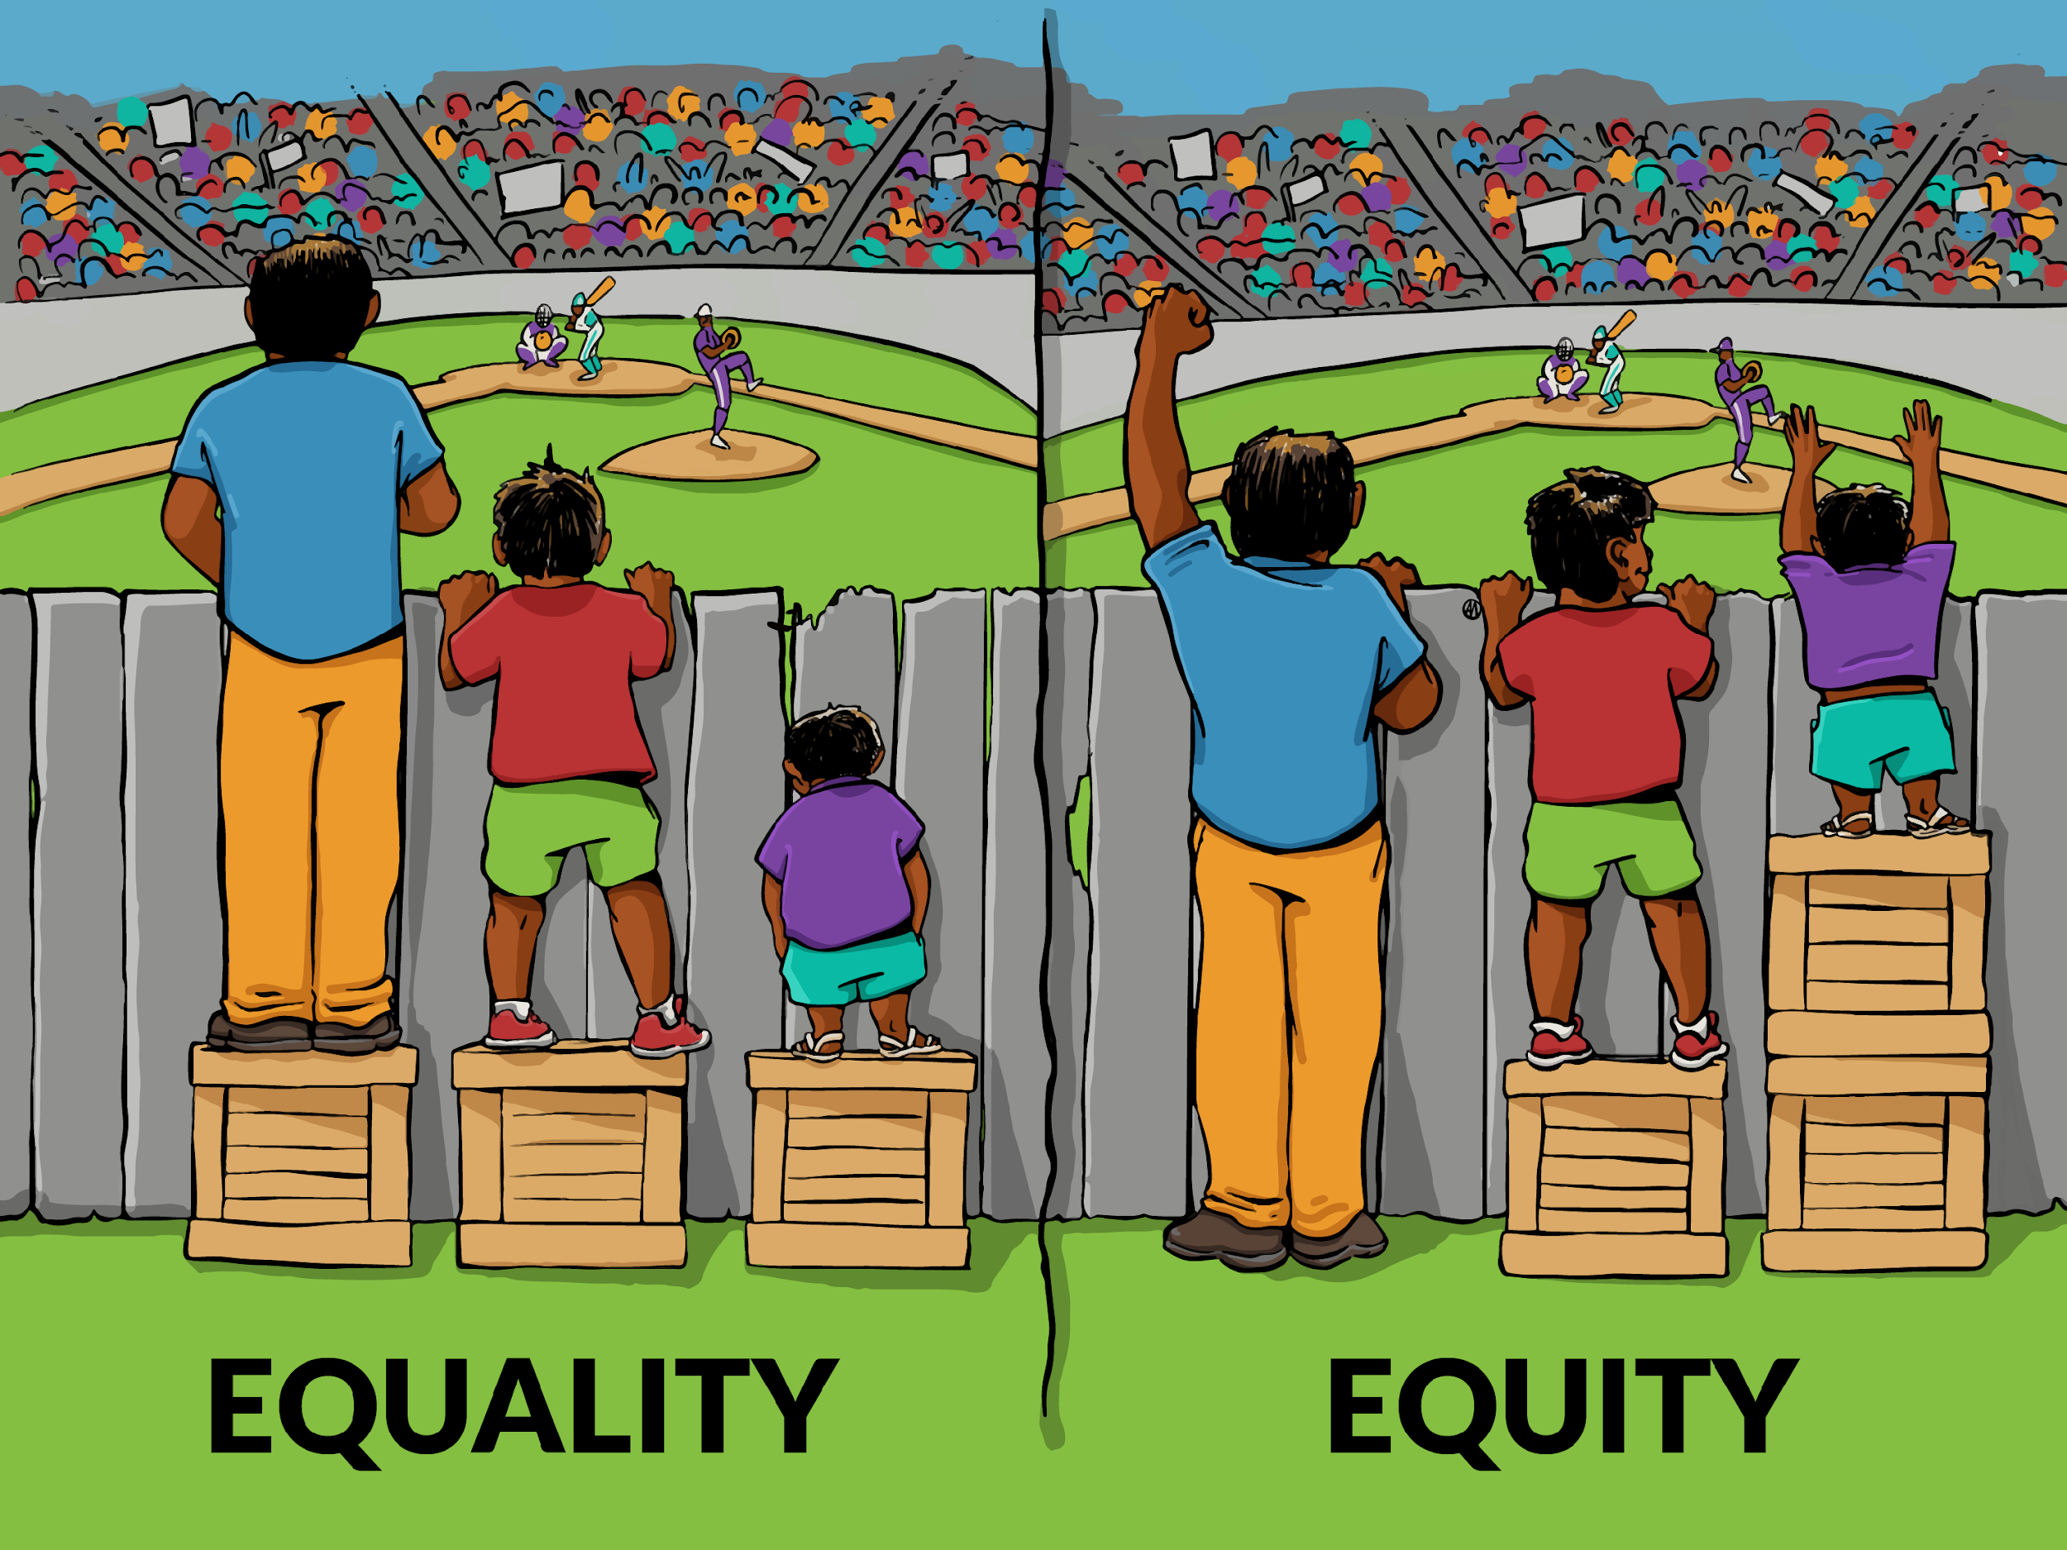
Social Justice & Equity
Social Justice: justice and fairness in society – in healthcare, education, housing, wealth distribution, and basic human rights.
Gender equity, LGBTQ+ rights, racial justice, and environmental justice are all examples of social justice issues.
Equity: equal opportunities, resources, and rights are afforded to all but will be allocated in different ways depending on the distinct circumstances and needs of a person, based on the barriers or privileges that person has been afforded by society

Slide 21
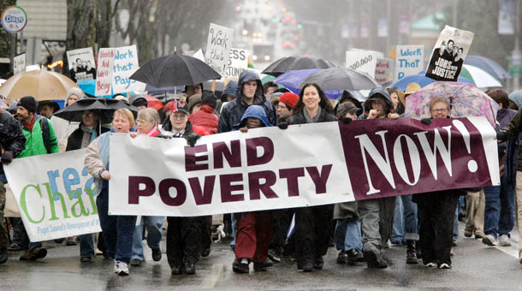
Discussion: Hidden Rules among Classes
Review the U.S. Poverty Guidelines and definition of a Living Wage
“The Hidden Rules among Classes”

Slide 22

Financial Resilience
The ability to withstand life events or changes to a person’s income and assets
Focuses on a person’s strengths and their ability to improve their situation 🡪 What we are doing in this course!
How can I increase my financial resilience?

Slide 23

Individual Course Goals
Journal:
What do you hope to accomplish by the end of this course?
What are the financial areas that are most important for you to address?

Slide 24
Learning Objectives
Upon conclusion of Workshop 1, participants will:
Have a basic understanding of what to expect in this course.
Recognize subtle and pervasive thoughts and reactions toward money.
Have a basic understanding of how mental health challenges and financial difficulties impact one another.
Learn new tips for mindfulness and self-care.
Have a basic understanding of poverty in the U.S. and how it relates to classism, intersectionality, privilege, and social justice.
Have a basic understanding of financial resilience and economic well-being.
Identify the financial areas that are most important for them to address.

Slide 25

Wrap-Up
Thank you all for your participation!
Are there any questions?
Homework:
Choose one money saving idea and commit to it for the week.
Facilitators will also commit to an idea.
Keep track of which ideas are going well and which are not.

